Slide 1
Introduction to statistical learning CS5565
Submitted By:
K N V Sai Indra kumar - 16265080

Slide 2
Dataset Description
Big mart Sales prediction using R.
The data scientists at BigMart have collected sales data for 1559 products across 10 stores in different cities for the year 2013. Now each product has certain attributes that sets it apart from the other products.
The aim is to build a predictive model to find out the sales of each product at a particular store so that it would help the decision makers at BigMart to find out the properties of any product or store, which play a key role in increasing the overall sales.

Slide 3
Approaches tried:
Linear Regression
Lasso Regression
Ridge Regression
Random Forest
XGBoost
FINAL RESULT:
The best score is obtained by XGBoost followed by RandomForest

Slide 4
Summary
Exploratory Data Analysis(EDA)- understand the dimensions and properties of the data visually, understanding the missing values and other things.
Data Preparation-deletion of the rows, mean/median/mode imputation divide the set into 2 datasets
Modelling-regression and other models are implemented on the obtained dataset.

Slide 5

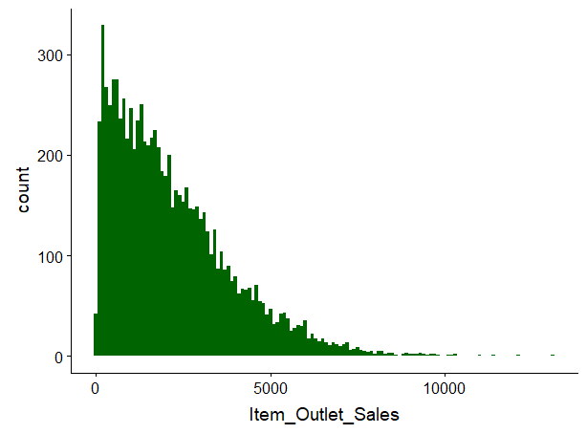
In eda we plot the individual variables individually. We visualize it using the continuous variables using histograms.

Slide 6

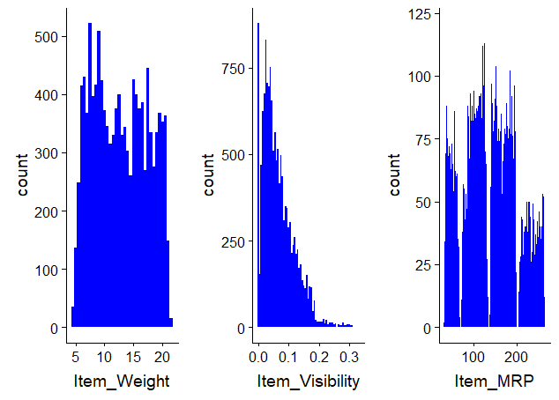



Similarly for all others using histograms

Slide 7
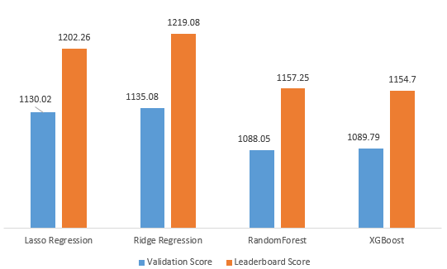
Finally after analysing al the values and models we obtain the following after considering all the RMSE scores.

Slide 8
THANK YOU

